Slide 1
Introduction to MongoDB
Storing Data

Slide 2
Overview
Storage Engine
Saving documents Updating documents

Slide 3





Storage Internals
How is data stored?
Your Application
Server Memory
Disk

Slide 4



Storage Internals
Your Application
0x4E48
0x594F
0x4E48
0x594F
Server Memory
Memory Mapped File
Disk

Slide 5
Storage Internals
Your Application
0x4E48
0x594F
0x4E48
0x594F
Server Memory
Memory Mapped File
Disk
0x594F
0x4E48
0x594F
0x4E48

Slide 6
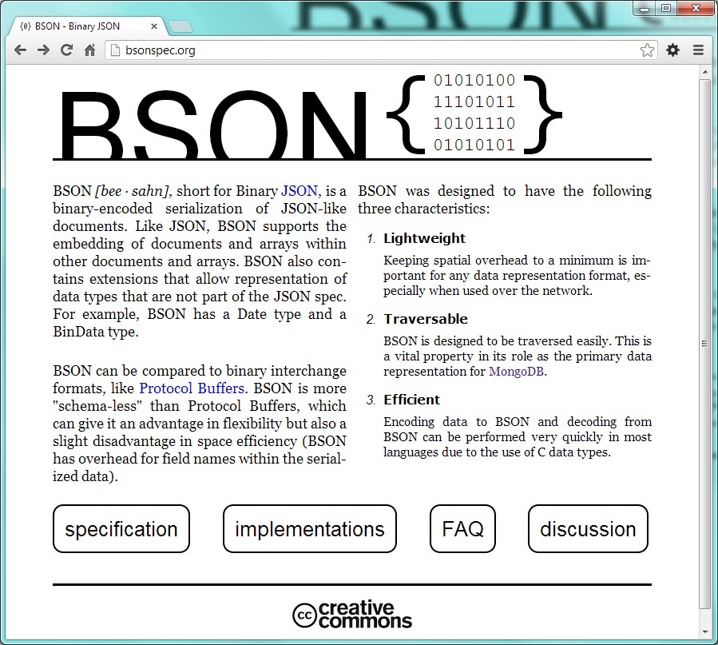
Storage Internals
How is data formatted?
Your Application
Server Memory
Disk

Slide 7
Saving Data
# 1: A document must have an
_id field.
# 2: There are very few rules.

Slide 8
Update
Atomic within a document
Targets individual field(s) Rich syntax support

Slide 9
Update
Which Document?
db.foo.update(query,update,options);
Collection Name
One? Many? Upsert?
What Change?

Slide 10
Find And Modify
Which Document?
Collection Name
db.foo.findAndModify( { query: <document>,
update: <document>, upsert: <boolean> , remove: <boolean>, new: <boolean>, sort: <document>,
fields: <document>} );
What Change?
Delete it?
Query order
Return new/old?
Return what?

Slide 11

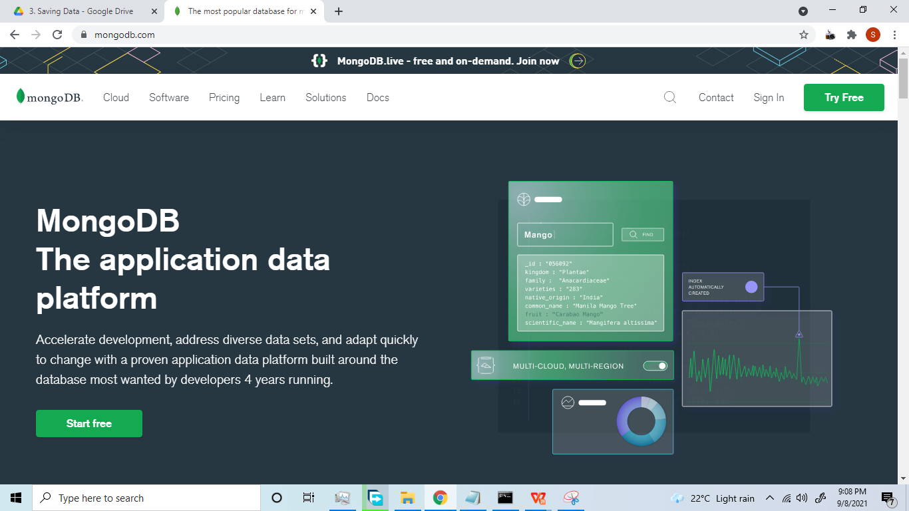

Slide 12
Summary
Storage
BSON
Memory Mapped File
New Documents
Save
Insert
Concurrency issue
Updates
Update
FindAndModify

